Slide 1














PERSONAL FINANCE MANAGEMENT SYSTEM
PROFESSOR:
CONTRIBUTORS:
MANUEL MONTROND
SRIKANTH NANDIKONDA
PRANATH GOPATHI
MEET BHANUSHALI
MANSI THORAT
SREERAM CHARAGUNDLA

Slide 2

ABOUT
The Personal Finance Management System is a database project facilitating intuitive tracking of income, expenses, and investments. Employing a robust relational database with encryption and access controls ensures secure data handling. Users can efficiently manage expenses, budgets, and investment portfolios, accessing customizable reports for a comprehensive financial snapshot. The project empowers individuals to make informed financial decisions through its user-friendly interface and sets the stage for scalability and future enhancements, making it an invaluable tool for personalized financial management.t

Slide 3

PROJECT OBJECTIVES
Streamlined Financial Tracking
Effective Budget Management
Secure Data Management
Real-time Insights

Slide 4


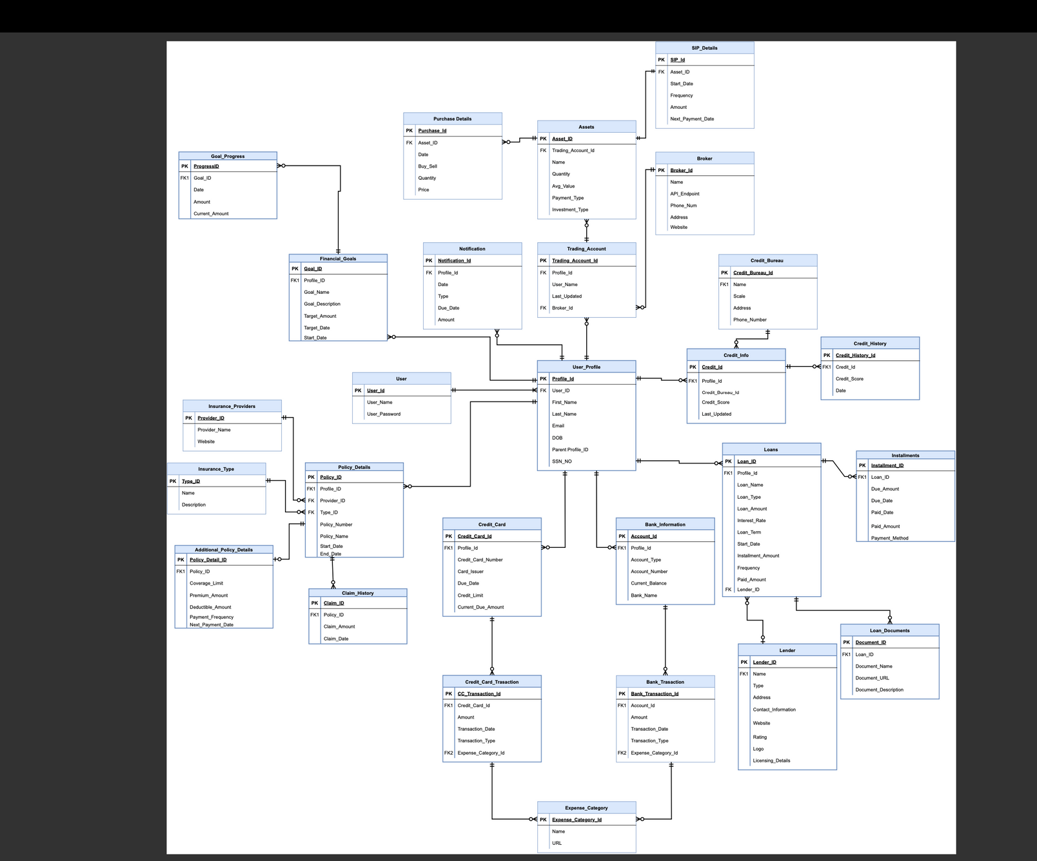
E-R DIAGRAM

Slide 5

STORED PROCEDURES
01.
Create PROCEDURE InsertNotificationsBasedOnDueDays-
This will enhance the system's responsiveness, ensuring timely and accurate notifications, and streamline the process of keeping users informed about critical financial events or activities within the Personal Finance Management System.
02.
CREATE PROCEDURE GetProfileExpenses-
Developing the "GetProfileExpenses" stored procedure is pivotal for optimizing data retrieval within our project. This stored procedure will be designed to fetch and organize profile-specific expense data efficiently.
CREATE PROCEDURE InsertLoanDealNotification-
Creating the "InsertLoanDealNotification" stored procedure is essential for automating the insertion of loan deal notifications in our project. This stored procedure will handle the efficient storage of relevant information associated with loan deals, ensuring that users receive timely notifications about their financial commitments.
03.

Slide 6
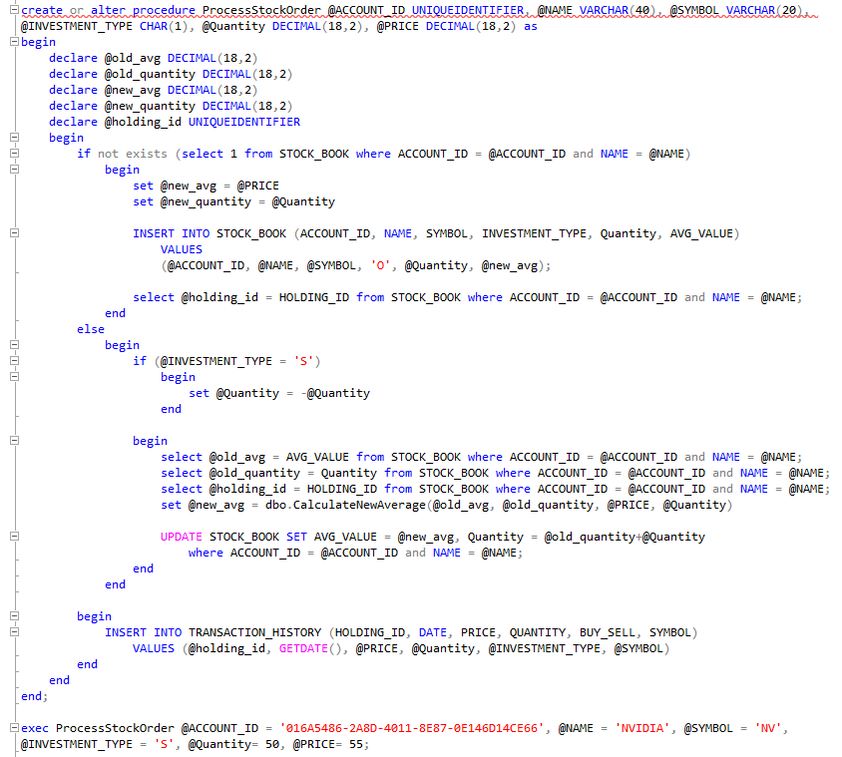

STORED PROCEDURE

Slide 7

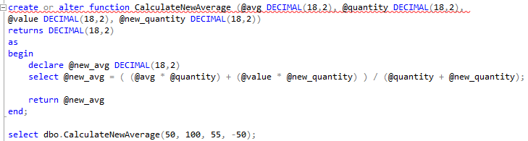

FUNCTION

Slide 8


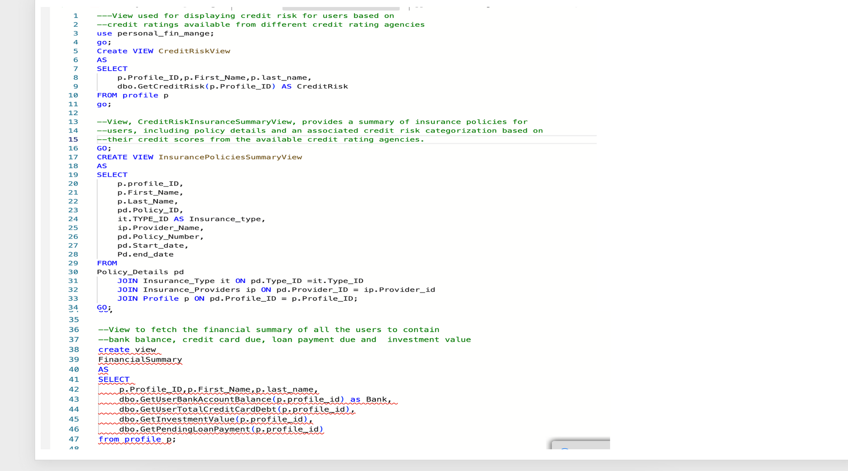
VIEWS

Slide 9

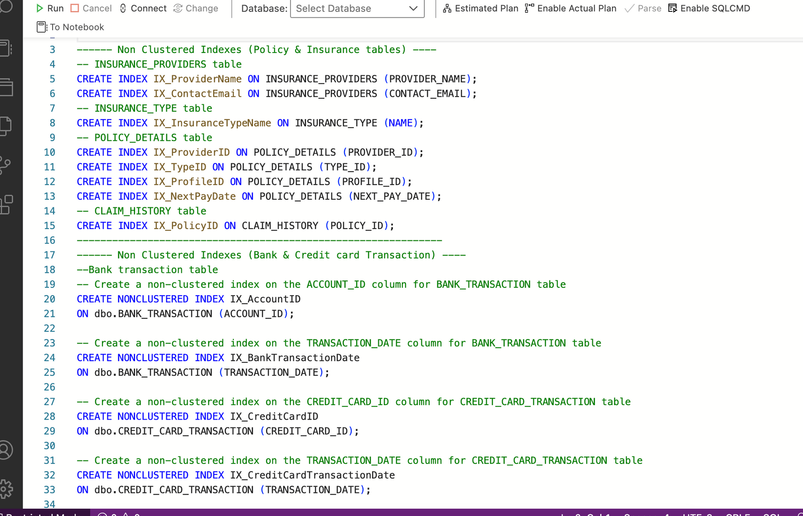

INDEXES

Slide 10
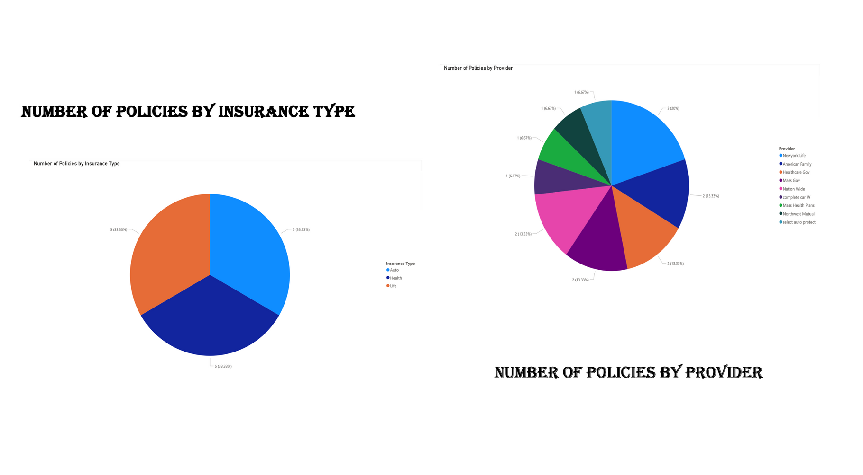
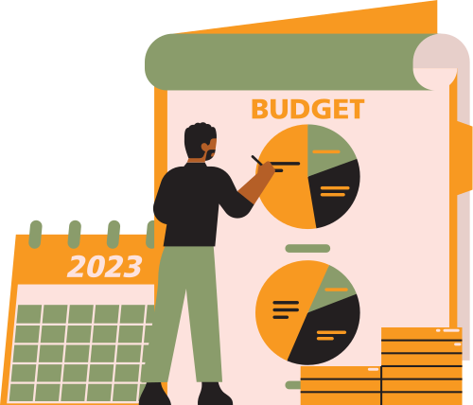
DATA VISUALIZATION

Slide 11

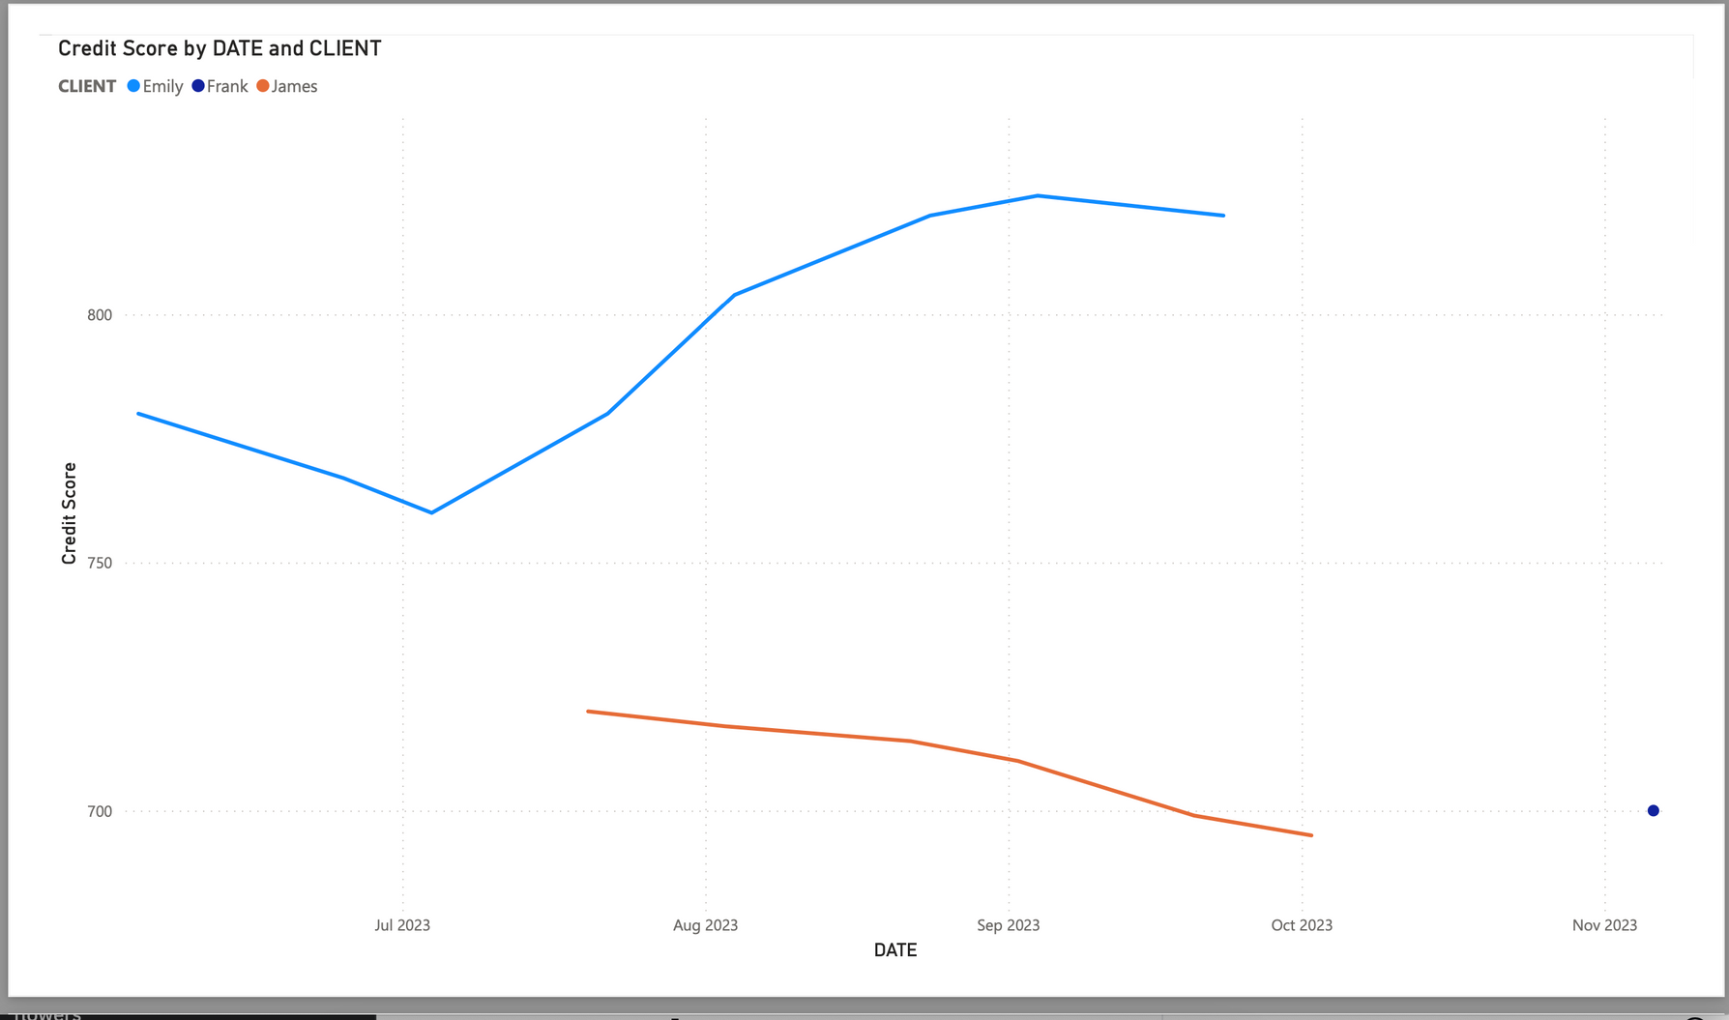
DATA VISUALIZATION

Slide 12



Thank you very much!

